Slide 1
Developing Integration Solutions using Microsoft BizTalk Server 2013
Routing

Slide 2

Course Outline
Module 1: Introduction to BizTalk Server
Module 2: Schemas
Module 3: Maps
Module 4: Testing and Deploying BizTalk projects
Module 5: Pipelines
Module 6: Routing
Lesson 1: Content Based Routing
Lesson 2: Failed Message Routing
Module 7: Adapters
Module 8: Web Services and WCF
Module 9: Introduction to Orchestrations
Module 10: Applied Orchestration Techniques
Module 11: Business Activity Monitoring
Module 12: Integrating Business Rules
Module 13: Deploying and Managing Applications
Module 14: Windows Azure BizTalk Services

Slide 3
Lesson 1: Content based routing
Publish Subscribe
Context and Content Based Routing
Demonstration: Property Promotion and Content Based Routing

Slide 4


Publish Subscribe
Receive Port
Orchestration
Send Port
Message Box
Notes:
In a publish/subscribe design, you have three components:
Publishers
Subscribers
Events
Publishers include receive ports that publish messages that arrive in their receive locations, orchestrations that publish messages when sending messages or starting another orchestration asynchronously, and solicit/response send ports that publish messages when they receive a response from the target application or transport.
Subscribers include send ports and orchestrations as well as request/response receive ports that subscribes to response messages to send back to the caller.

Slide 5
Subscriptions
Activation Subscription
Activate, or create, a new instance of the subscriber
For example Send Port filters or Filters to initiate new instances of Orchestrations
Exist while Port or Orchestration is Enlisted
Instance Subscription
Routes message to an already active instance of a subscriber
For example instances of an orchestration or receive ports waiting for a response
Removed when the subscription has been fulfilled.
Notes:
In BizTalk Server, there are two main types of subscriptions: activation and instance.
An activation subscription is one specifying that a message that fulfills the subscription should activate, or create, a new instance of the subscriber when it is received. Examples of things that create activation subscriptions include send ports with filters or send ports that are bound to orchestrations, and orchestration receive shapes that have their Activate property set to true.
An instance subscription indicates that messages that fulfill the subscription should be routed to an already-running instance of the subscriber. Examples of things that create instance subscriptions are orchestrations with correlated receives and request/response-style receive ports waiting for a response from BizTalk Server.
The difference between the two types of subscription at the information level is that an instance subscription includes the unique instance ID, stored in the subscription table in the master MessageBox database. When an orchestration instance or receive port completes processing, instance subscriptions are removed from the MessageBox while activation subscriptions remain active as long as the orchestration or send port is enlisted.

Slide 6


The MessageBox database and Message Agent
Things stored in the MessageBox
Subscriptions
Message data and context
Orchestration state
Queues and state for hosts
Tasks performed by the Message Agent
Act as the gateway to the MessageBox
Fulfilling subscriptions
Publishing messages
Subscribing to messages

Slide 7
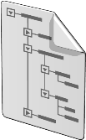
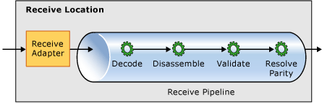
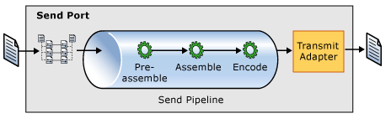
Context based Routing
BTS.ReceivePortName = ”RcvOrder”
RcvOrder
SndOrder
MsgBox

Slide 8
Content based Routing
CustomerType = ”VIP”
SndOrder_VIP
RcvOrder
MsgBox
Order.xml
SndOrder_Default
CustomerType != ”VIP”

Slide 9
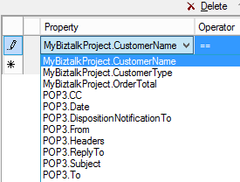
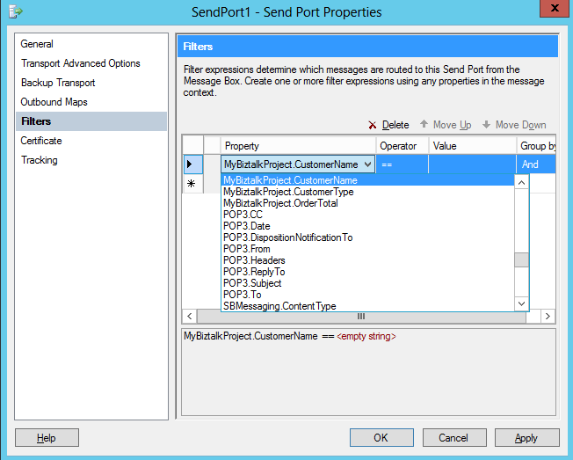

Property Promotion
Order
- Nummer
Kund
Namn
Typ
...
- Datum
OrderRader
- OrderRad
- ...
.
Property Promotion
- CustomerName
- CustomerType
- OrderTotal
Faktura
- Nummer
Kund
Namn
...
- Datum
FakturaRader
FakturaRad
...
.
Property Schema

Slide 10

Demonstration: Content based routing
Promoting a property
Content based routing
Notes:
(Slide 10)
Open C:\Demos\Mod6\Start\Mod6\Mod6.sln
Open Customers.xsd and expand the schema
Right click Category and select Promote – Quick promotion.
A new propertyschema is created and Category is added.
Remove Property 1.
Build and Deploy the project.
In the Administration Console, Import C:\Demos\Mod6\Mod6Bindings.xml.
Modify SendGoldCustomer, add the filter Mod6.PropertySchema.Category == Gold
Modify SendSilverCustomer, add the filter Mod6.PropertySchema.Category == Silver
Start the Mod6 application.
Drop Gold and Silver messages into the FileDrop folder, note the outcome.

Slide 11
Lesson 1: FAILED MESSAGE ROUTING
Configuring Failed Message Routing

Slide 12
Failed Messages
Example of a Non-Resumable situation:
The response message fails in a solicit/response send port.
The request message fails in a request/response port.
Failed Messages gets placed in the Suspended queue
State is either
Suspended (Resumable) or
Suspended (Non-Resumable)
Handling message failure in Ports
Suspend or
Select the checkbox: Failed Message Routing

Slide 13

What does Failed Message Routing do?
1
2
3
Clone the message
Demote all message properties
Promote ErrorReport related properties
4
Publish the message to the MessageBox
Caution!
Using Failed Message Routing no messages are Suspended – and can NOT be resumed!

Slide 14
Steps required to use Failed Message Routing
1
2
3
Select the Enable routing for failed messages checkbox
Subscribe to one of the ErrorReport properties
Process the failure as appropriate
ErrorReport properties
FailureCode*
FailureCategory*
Description
MessageType*
ReceivePortName(*)
InboundTransportLocation(*)
SendPortName(*)
OutboundTransportLocation(*)
ErrorType*
RoutingFailureReportID*
-FailureCo.. -FailureCat.. ... .. .

Slide 15
Demonstration: Failed message routing
Failed message routing
Notes:
(Slide 15)
Continue with previous demo...
Drop the Customer_ERROR.xml message. No output.
View the suspended message in Administration Console.
Enable Failed Message Routing on the Receive Port.
Modify SendErrors, add the filter ErrorReport.ErrorTypeExists
Send the Customer_ERROR.xml message again, note the output.

Slide 16
Summary
BizTalk Server is based on the Publish-Subscribe pattern and subscriptions.
The MessageBox is the center of subscription evaluation and messaging.
Routing can be done on context or content.
A special type of context information that can be routed on is that of a failed message.

Slide 17
Q & A
Routing

Slide 18

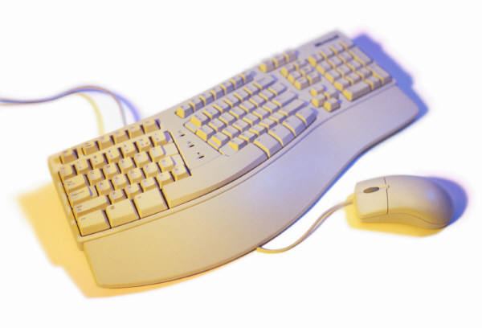
Hands-On-Labs
Content based routing
Create receive ports and receive locations
Create send ports and define filters
Configure security settings
Create custom pipelines
Build and test the solution

Slide 19

Quiz
What are subscriptions?
How do you enable content based routing?

